Slide 1
DATA Science Internship (OESON)
Statistical analysis of live Data for stock prices
Abhishek Harsha Raj

Slide 2
Dataset
Live stock data from Yahoo Finance which consists stock values from Microsoft, Apple and Tesla.
Dataset contains stock values from 2018-2023.
Dataset also contains S&P500 values during same time period.
SP_500 is a stock market index tracking the stock performance of 500 large companies listed on stock exchanges in the united states

Slide 3
Problem Statement
Prepare a statistical report capturing live data for stock prices of major us companies like Microsoft, Apple and Tesla to study the behaviour of the company stock.

Slide 4
Objectives
Make a comparative descriptive statistics on the value of each stock between 2018-2023.
Make a regression model over the percentage change in stock vs market return on the stock for each company.
Compare the value of beta to show the progress of the stock and the risk value involved.

Slide 5
descriptive STATISTICS
Microsoft stock
Mean | 194.4709
Standard Error | 2.0764814
Median | 203.58
Mode | 95.139999
Standard Deviation | 74.232396
Sample Variance | 5510.4487
Kurtosis | -1.2879577
Skewness | 0.1498324
Range | 258.56
Minimum | 86.059998
Maximum | 344.62
Sum | 248533.81
Count | 1278
Tesla stock
Mean | 131.8952
Standard Error | 3.277467
Median | 96.57333
Mode | 24
Standard Deviation | 117.1666
Sample Variance | 13728.01
Kurtosis | -1.25726
Skewness | 0.470592
Range | 399.3967
Minimum | 12.07333
Maximum | 411.47
Sum | 168562.1
Count | 1278
Apple stock
Mean | 98.5741
Standard Error | 1.291672
Median | 95.0875
Mode | 127.82
Standard Deviation | 46.17614
Sample Variance | 2132.236
Kurtosis | -1.58204
Skewness | 0.121834
Range | 146.635
Minimum | 35.995
Maximum | 182.63
Sum | 125977.7
Count | 1278
Microsoft has the highest mean among the three stocks.
Tesla has the highest standard deviation among the three stocks which indicates it is the most volatile stock, while apple is the most stable stock.
Since Apple has the highest mode it is the most popular stock.
Since the skewness is positive i.e. more data is present in the right handed tail than in the left handed tail.

Slide 6
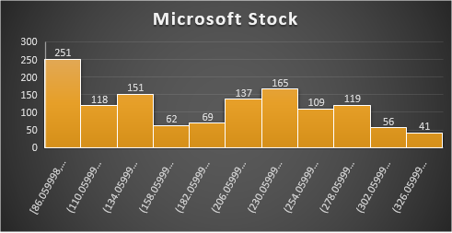
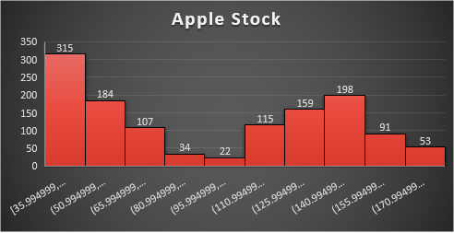
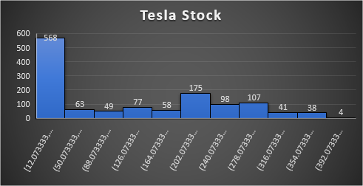
descriptive STATISTICS- Histogram
The histogram shows us that all the three stocks has a right skew.
The distribution of all three stocks shows us a Platykurtic curve since the kurtosis value of all three distribution is less than 3.

Slide 7
descriptive STATISTICS- Scatterplot
From the scatter plot, we can see that the Tesla stock had the highest market when compared to Microsoft and Apple.
From 2018-2021 we can see that the stock price of the three companies gradually increase and from 2022-2023 the stock price show a slight downward trend.

Slide 8
Regression MODELS
The beta values of the stocks are shown below:
Microsoft:0.494478
Tesla:0.12650452
Apple:0.410431
Since the beta value of Microsoft stock is the higher than that of Tesla and Apple it is more risker to buy.

